Slide 1
Defense Mechanism Genes
helps competition on
carries
Biofilm
Transposon
facilitate the spread of
A deep ocean
particle-attached
microbe

Slide 2
Transposon
spreads
carries
helps competion, defense on
Biofilm
Defense
mechanisms
a particle-attached,
deep ocean microbe

Slide 3
Transposons
spreads
carry
helps competion and defense on
The switch to particle lifestyle
Defense
mechanism
cassettes
A deep-ocean microbial community

Slide 4
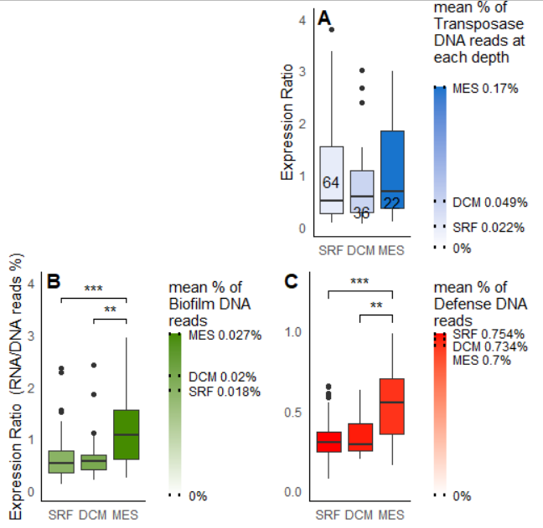


Slide 5
